Slide 1
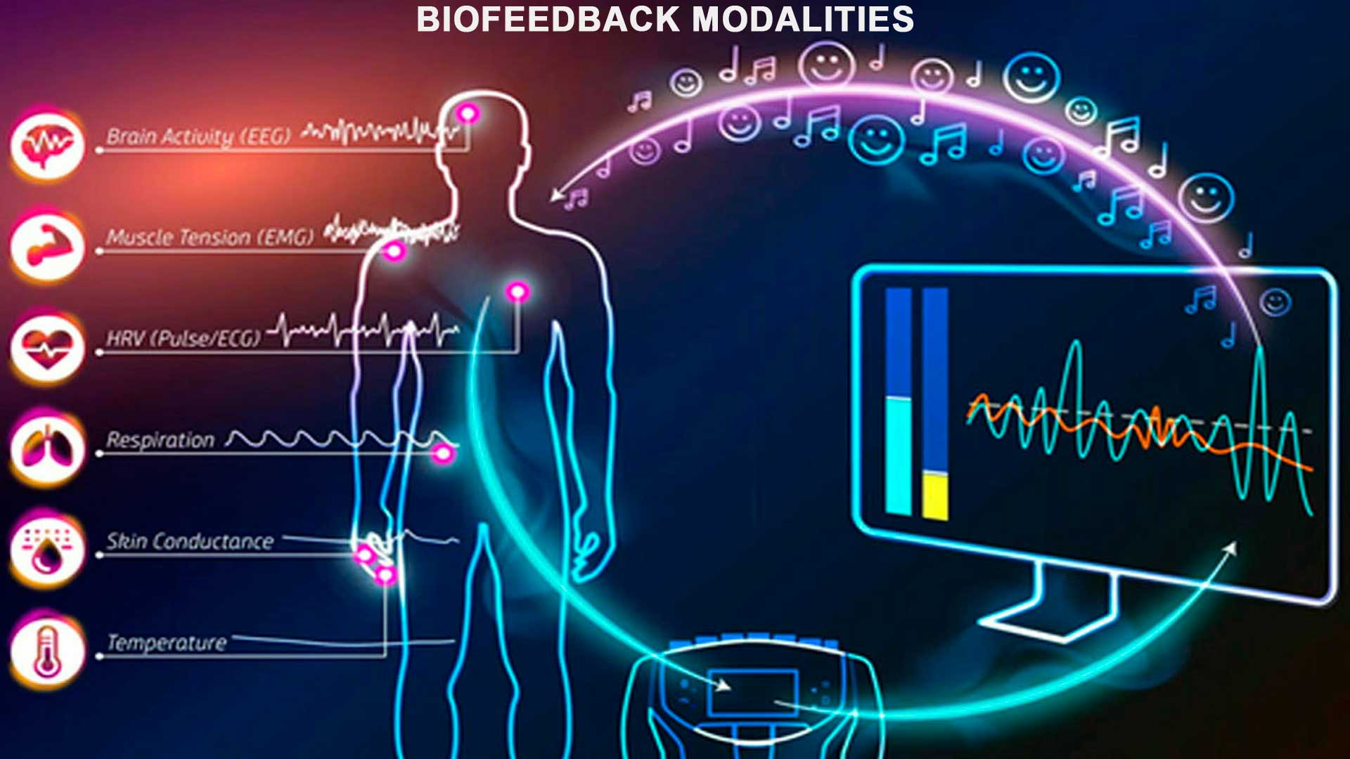
生理回饋評估與治療
成大醫院精神部 洪妮君專科護理師

Slide 2
講師
台大護理系畢
台大精神科精神官能症病房3年1月
中正大學心理學研究所畢
戊功大學行為醫學研究所畢
奇美醫院精神科13年1月
成大醫院精神科迄今
心理師執照
專科護理師執照
部定講師
嘉南藥理科技大學兼任講師1年
長榮大學護理系兼任講師1年
對於可以重複練習的運動都很有興趣，目前著迷於精準運動及瑜珈

Slide 3
大綱
生理回饋原理及簡介
生理回饋評估
生理回饋治療
基礎生理回饋治療
心跳變異生理回饋治療(Heart rate variability Biofeedback)

Slide 4
前測
請問生理回饋治療是那一取向治療？
生理回饋的測量方式有幾種？
什麼是心跳變異率？
為什麼要訓練緩慢呼吸？

Slide 5
生理回饋治療原理

Slide 6
自主神經系統

Slide 7
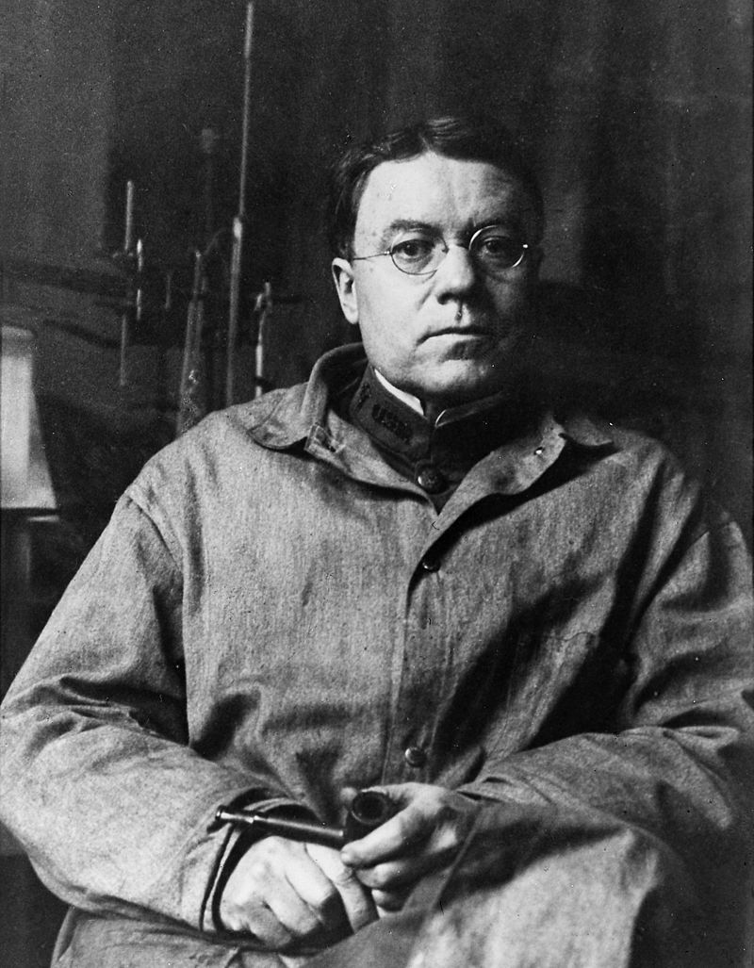
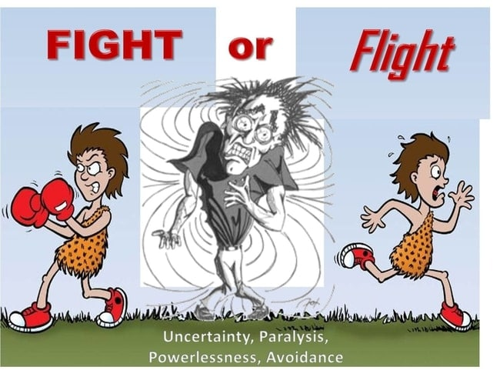
Stress theories for biofeedback
Walter Bradford Cannon (1871-1945)
Notes:
Let’s talk about stress theory. The first one is Cannon’s theory. He was a American physiologist, professor and chairman of the department of physiology in Harvard medical school in 1902. He developed the theory of homeostasis and coined the term“ fight, flight or freeze response “
Homeostasis theory is a state of physiological calmness or balance. This condition occurs when our bodily functions are running smoothly with low stress levels. When exposed to stressors, this causes an imbalance when the body responds to the perceived threat. After stress pass by, the organism tries to return to normal functioning.
The fight-or-flight-or-freeze response –we also called hyperarousal or the acute stress response-- is a physiological reaction that occurs in response to a perceived harmful event or threat. Cannon’s theory states that physical reaction is discharged by sympathetic nervous system, preparing the animal for fighting or flight.

Slide 8
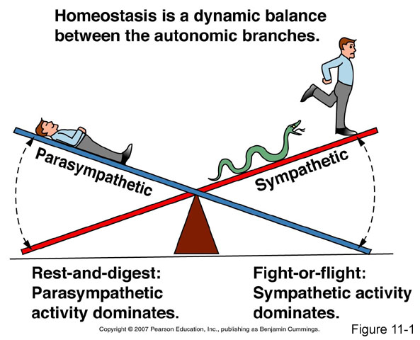
Notes:
So how does homeostasis work when the bodily function is imbalance ?
The parasympathetic nervous system (PNS) is one of the autonomic nervous system . It is in opposition to the sympathetic nervous system . The parasympathetic nervous system predominates in “quiet, rest and digest” conditions. While the sympathetic nervous system drives the “fight or flight” response in stressful situations, the PNS is to conserve energy to be used later and to regulate bodily functions to back calmness and decrease metabolic level.

Slide 9
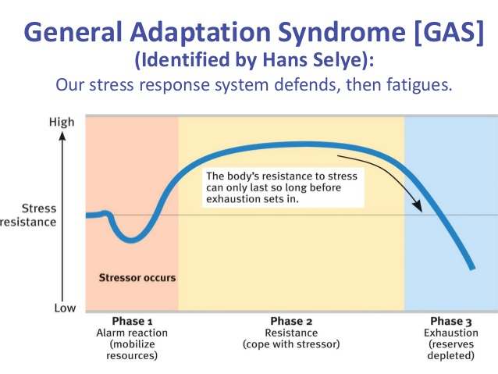
Selye’s general adaptation syndrome
Notes:
Next we talk about the general adaptation syndrome (GAS). This is developed by Hans Selye, describes the pattern of responses how the body goes through after a stressor. There are three stages: alarm, resistance, and exhaustion. In this figure, the vertical axis is stress resistance, that means the ability of one person to resist the stress. The horizontal axis is time phase.
The first phase, the alarm stage when the stressor occurs, we first perceive something as stressful, and then the body initiates the fight-or-flight response. This is jus mentioned: hyperarousal.
Then we maybe found ways to relief this uncomfortable situation. Our body would activate a higher metabolic level in an effort to offset the stress. This is the resistence phase. But we could not maintain this level for a long time.
If we prolonged exposure to the stressor, our body’s resources would be depleted. This is the third phase-exhaustion. It would suppress our immune system and cause bodily functions to deteriorate. This maybe lead to many illnesses, including heart disease, digestive problems, depression, and diabetes.

Slide 10
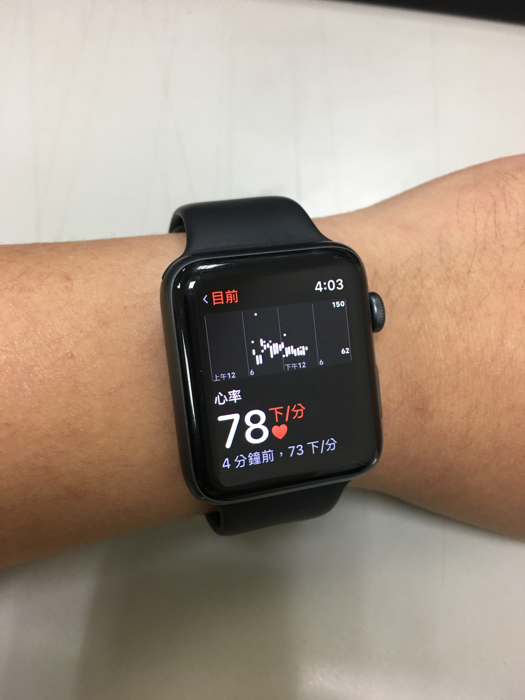
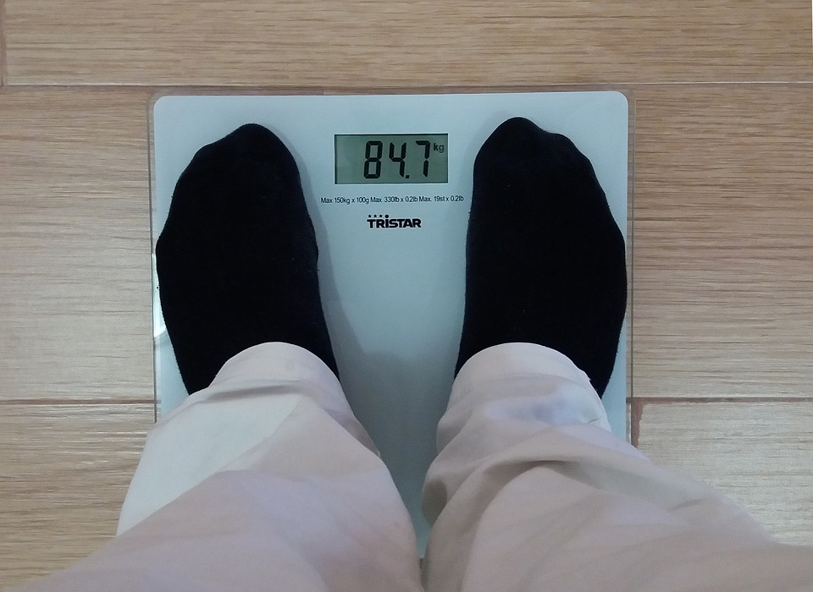
生理回饋是什麼？
以生理訊號監控身體變化，經過儀器將生理現象轉換成可理解的數值，提供即時以視覺/聽覺回饋給個案
根據結果增加對身體變化的敏感度及對變化過程的控制。

Slide 11
生理回饋類型
心跳
血液容積脈搏波(Blood volume pulse, BVP)
心電圖( Electrography; EKG)
其他生理測量(for visualized physical condition):
指溫
呼吸
皮膚導電度 (skin conduction)
肌電圖(Electromyography)

Slide 12
常見的生理回饋儀
指溫 Temperature
肌電Electromyography
膚電 Skin Conductance
呼吸Respiration
末梢血流Blood Vessel pulse
心跳變異生理回饋
心電圖ECG
神經回饋
腦波EEG

Slide 13
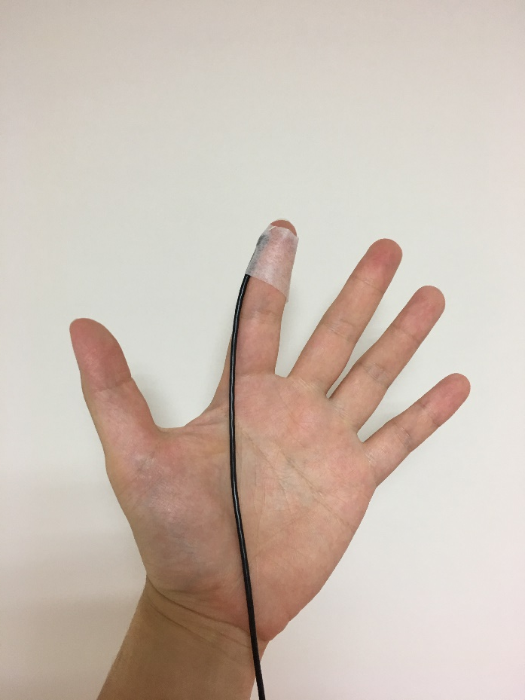
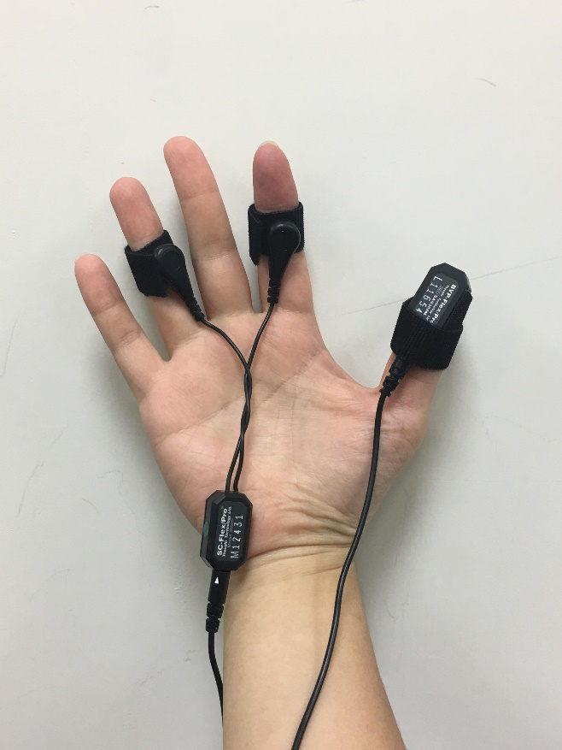
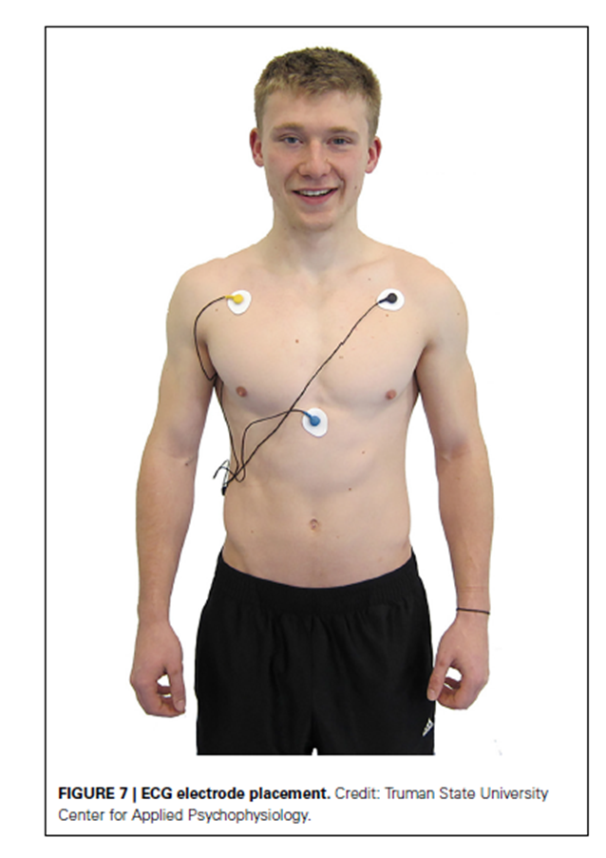

Slide 14
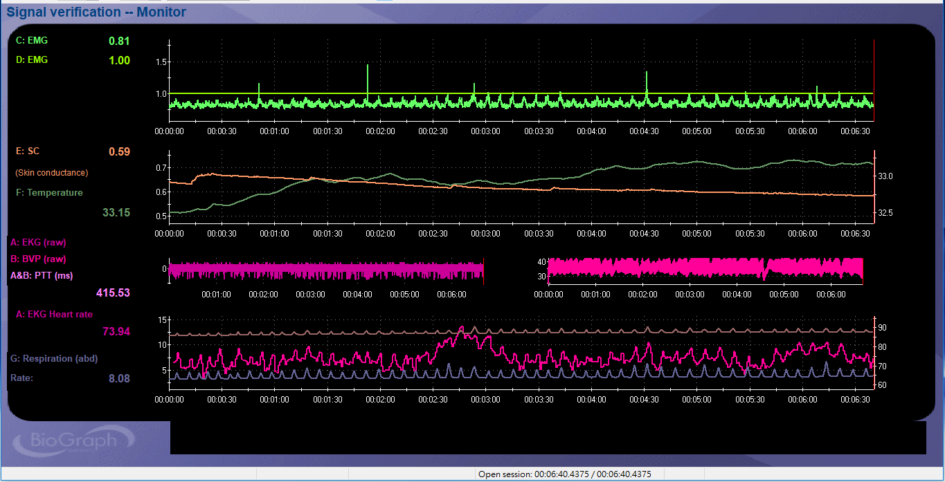
Pschophysicological stress profile(PSP)
Notes:
This is the result. In the first figure, you can see the fluorecent green line. This is electromyography data. On the left side, there are the power of muscle tension—0.81Hz. In the second figure, there are two line—green and orange one—these are the skin conduction and thermal temperature. As time go by, you can see the green one was inclined and the orange one was declined. This means the client was more and more relaxed.

Slide 15
Goals of Biofeedback Intervention
Budzynski(1973)
Stage1
Stage2
訓練：依據BF的訊號引導，學習如何控制這些反應
Stage3
將所學類化到日常生活中
對於內在歷程(不適應的反應)增加覺察(awareness)
Setting up for success
在沒有BF儀器的情形下藉由內在線索(internal cue)達到自我調節(self regulation)

Slide 16
生理回饋評估
基準期
壓力期
恢復期
放鬆期
搭配會談，可了解個案在休息、面對壓力時的身心反應，
以及遭逢壓力後的恢復效率(和放鬆能力)。
可類推到他生活情境中面對壓力的反應， 以及是否有不良的因應。

Slide 17
基準期
做為比較的基準點
安靜(不說話)坐著休息5分鐘
閉眼/張眼(凝視點)

Slide 18
壓力期
生理壓力：傾斜床，冰水，噪音．．．
認知作業：叫色測驗，算術
情緒：回憶壓力事境
當場實作，如打字
➔個體對於不同的刺激會有不同的反應，可更貼近生活中的壓力情境。
➔建議情緒性質的壓力作業放在最後，因為需較長的回覆時間(Harvey,2012)

Slide 19
壓力期
叫色測驗(stroop color naming task)

Slide 20
恢復期
安靜(不說話)坐著休息5分鐘
閉眼/張眼(凝視點)
若有多個壓力期，一定要在壓力期之間設置恢復期。
Psp5.放鬆期
用自己的方法放鬆
目的：為了解訓練前的放鬆能力/活化副交感神經系統的能力

Slide 21
Interpretation of PSP data
壓力下的反應(Reactivity)大小
Hyper-reactivity反應是否過大 / Hypo- reactivity反應是否過低
壓力後回復/恢復(Recovery)效率
回復的型態(pattern)
• Difficult to return to baseline 無法回復
• Immediately recovery 立即回復
• Slower recovery 延遲回復
回復的時間(time)
• 回復到基準期所需要花的時間

Slide 22
PSP data 結合會談評估
對照生理回饋評估的反應，評估個案自我覺察度
PSP反應大，但個案是否有覺察
對照會談或自陳問卷評估
不須反應卻反應→肌肉不自主緊繃
是否有其他不良的因應、性格因素、生活型態導致壓力反應持續
如：Rumination
身心反應不佳 + 生活姿勢不良。

Slide 23
心率變異生理回饋治療
Heart rate variability Biofeedback(HRV-BF)

Slide 24
一個人有意的呼吸5, 7.5, 15, 30次每分鐘，四種頻率的綜合圖。
Notes:
HRV振幅，隨著呼吸頻率而不同。
振幅的改變是HRV低谷的減少所致。
低谷不再那麼低。
因此，當呼吸頻率提升，平均心跳率也提升。
平均心跳率是為交感／副交感為主的指標
HRV頻率和呼吸頻率共變。

Slide 25
緩慢呼吸、心率與自律神經
peak
SNS 上升
SNS 下降
Vagal(PSNS)上升
valley

Slide 26
心肺同步(呼吸竇心率不整) (respiratory sinus arrhythmia, RSA)
在緩慢呼吸的狀態下，心跳率與呼吸是同步。
During inhalation, the cardiovascular center withdraws vagal inhibition of SA node(speeding the heart rate)；吸氣時、心跳率上升
During exhalation, it restores vagal inhibition(slowing the heart) via release of acetylcholine；吐氣時，心跳率下降
因此，HRV的振幅和頻率是和呼吸的頻率與深度有密切相關。

Slide 27
心肺同步(呼吸竇心率不整) (respiratory sinus arrhythmia, RSA)

Slide 28
呼吸經由感壓反射調節心跳、血壓→調節情緒反應和呼吸效率
2. 將訊號傳回到大腦
3. 迷走神經調節心率
1. 感壓反射偵測到動脈壓改變
Shaffer, F., McCraty, R., & Zerr, C. L. (2014). A healthy heart is not a metronome: an integrative review of the heart's anatomy and heart rate variability. Frontiers in psychology, 5.

Slide 29
HRV 與 自主神經失調
時域分析：透過5分鐘HRV的測量可得
SDNN、SDANN：正常竇性心搏間期之標準差→整體心跳變異指標
NN50：正常心跳間期超過50毫秒的比率。
pNN50：相鄰正常心跳間期超過50毫秒的比率。心跳變異指標(vagal)
rMMSD：正常心跳間期差值平方合的均方根。→副交感神經指標

Slide 30
HRV-BF作法
評估呼吸型態與心跳變異率
逐步放慢、習慣4.5-7下/分的呼吸
於4.5-7下/分間找到HRV與呼吸型態最佳的速率
依據找到的最佳呼吸速率持續練習

Slide 31
HRV-BF: how and why does it work (Lehrer & Gevirtz, 2014)
1. Slow breathing→vagal afferent pathway→frontal cortical area→ANS
(1) Vagal afferent pathway→Hypothalamic vigilance area→增加注意力與警覺
(2) Vagal afferent pathway→thalamus→frontal cortical area平靜→降低焦慮與擔憂
2. Strengthening of homeostasis in the baroreceptor(Vaschillo et al., 2002; Lehrer et al., 2003)
透過腦島的孤束核(nucleus tractus solitarius)→腦島延伸路徑到杏仁核，抑制杏仁核活動。

Slide 32
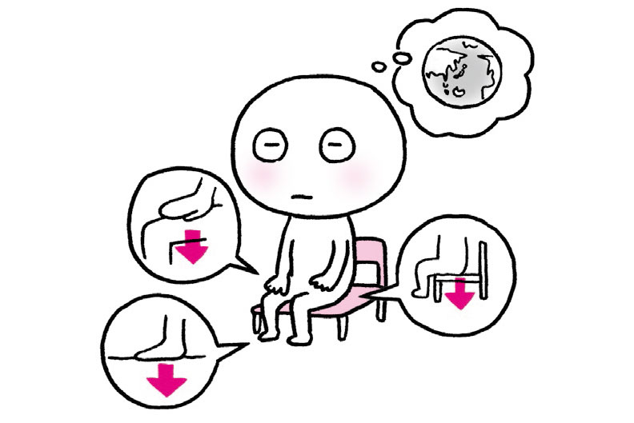
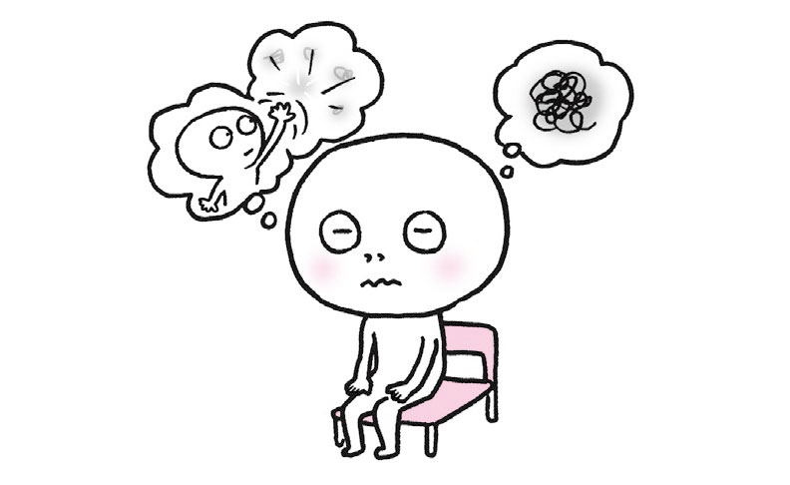
Biofeedback intervention programs
Relaxation methods ➔結合BF
Body awareness/ Body scan
Progressive muscle relaxation (PMR)
Diaphragmatic breathing
Autogenic training / Auto Suggestion
Meditation
Mindfulness

Slide 33
HRV與壓力、健康、情緒調節
HRV振幅與壓力
HRV和壓力程度與交感神經為主有高度相關。
高壓時，越高的交感神經為主導，容易有不理想的呼吸方式（短淺、不規律、快速）-->HRV的振幅越低
一般成人呼吸約15次/分。
相對是”fight or flight”的反應。
提高肌肉緊張度、提高心跳率….
慢性交感神經主導的情況
Notes:
當在壓力情境下，人傾向短淺且快速的呼吸。
呼吸是在面對提升的壓力情境中，最開始的反應。
壓力導致快速的呼吸→快速呼吸導致交感為主

Slide 34
HRV與壓力、健康、情緒調節
緩慢呼吸(4.5-7下/分)→提高HRV
增進氣體交換效率、自主神經平衡
長期練習可以協助增進感壓反射的活性，幫助它，即使在未回饋下可以自動調節。
每天兩次，持續三個月，可以增加休息時的baroreflex gain(Lehrer et al., 2003)，具有神經可塑性(Nolan et al., 2010)

Slide 35
HRV 與臨床疾患
低心跳變異率
罹患心肌梗塞的死亡率(La Rovere et al., 1998)、高血壓(Schroeder et al., 2003) 有關；
焦慮症(Friedman, 2007; Licht, De Geus, Van Dyck, & Penninx, 2009)、恐慌症(McCraty, Atkinson, Tomasino, & Stuppy, 2001; Petrowski, Herold, Joraschky, Mück-Weymann, & Siepmann, 2010)、創傷後壓力疾患(Hauschildt, Peters, Moritz, & Jelinek, 2011)和憂鬱(Kemp et al., 2010; Taylor, 2010)。

Slide 36
HRVB 療效--精神科、情緒調節
MDD (Karavidas et al., 2007; Lin et al., 2013)； Depression in Fibromyalgia(Hassett et al., 2007)；產後憂鬱(Kudo, 2014)
Anxiety disorder (Tabachnick, 2015; Henriques, 2011; Kemp, 2012) Performance anxiety(Thurber et al., 2010)
Substance use disorder(Eddie et al., 2014,2015; Lin et al., 2016), Alcohol dependence(Penzlin et al., 2015)
PTSD(Zucker et al., 2009; Tan et al., 2011)
Food cravings (Meule, 2012)
敵意(Lin et al., 2015)

Slide 37
HRVB 療效—內科
Asthma(Lehrer et al., 1997,2004)
Heart failure(Swanson et al., 2009)
COPD(Giardino et al., 2004)
CAD(Cowan et al., 2001, Lin et al. 2015)
Hypertention, prehypertention(Nolan et al., 2010,2012, McCraty et al., 2003; Wang et al., 2010,2012)
Irritable bowel syndrome(Sowder et al., 2010, Stern et al., 2014)

Slide 38
治療中最重要的是…..

